Slide 1
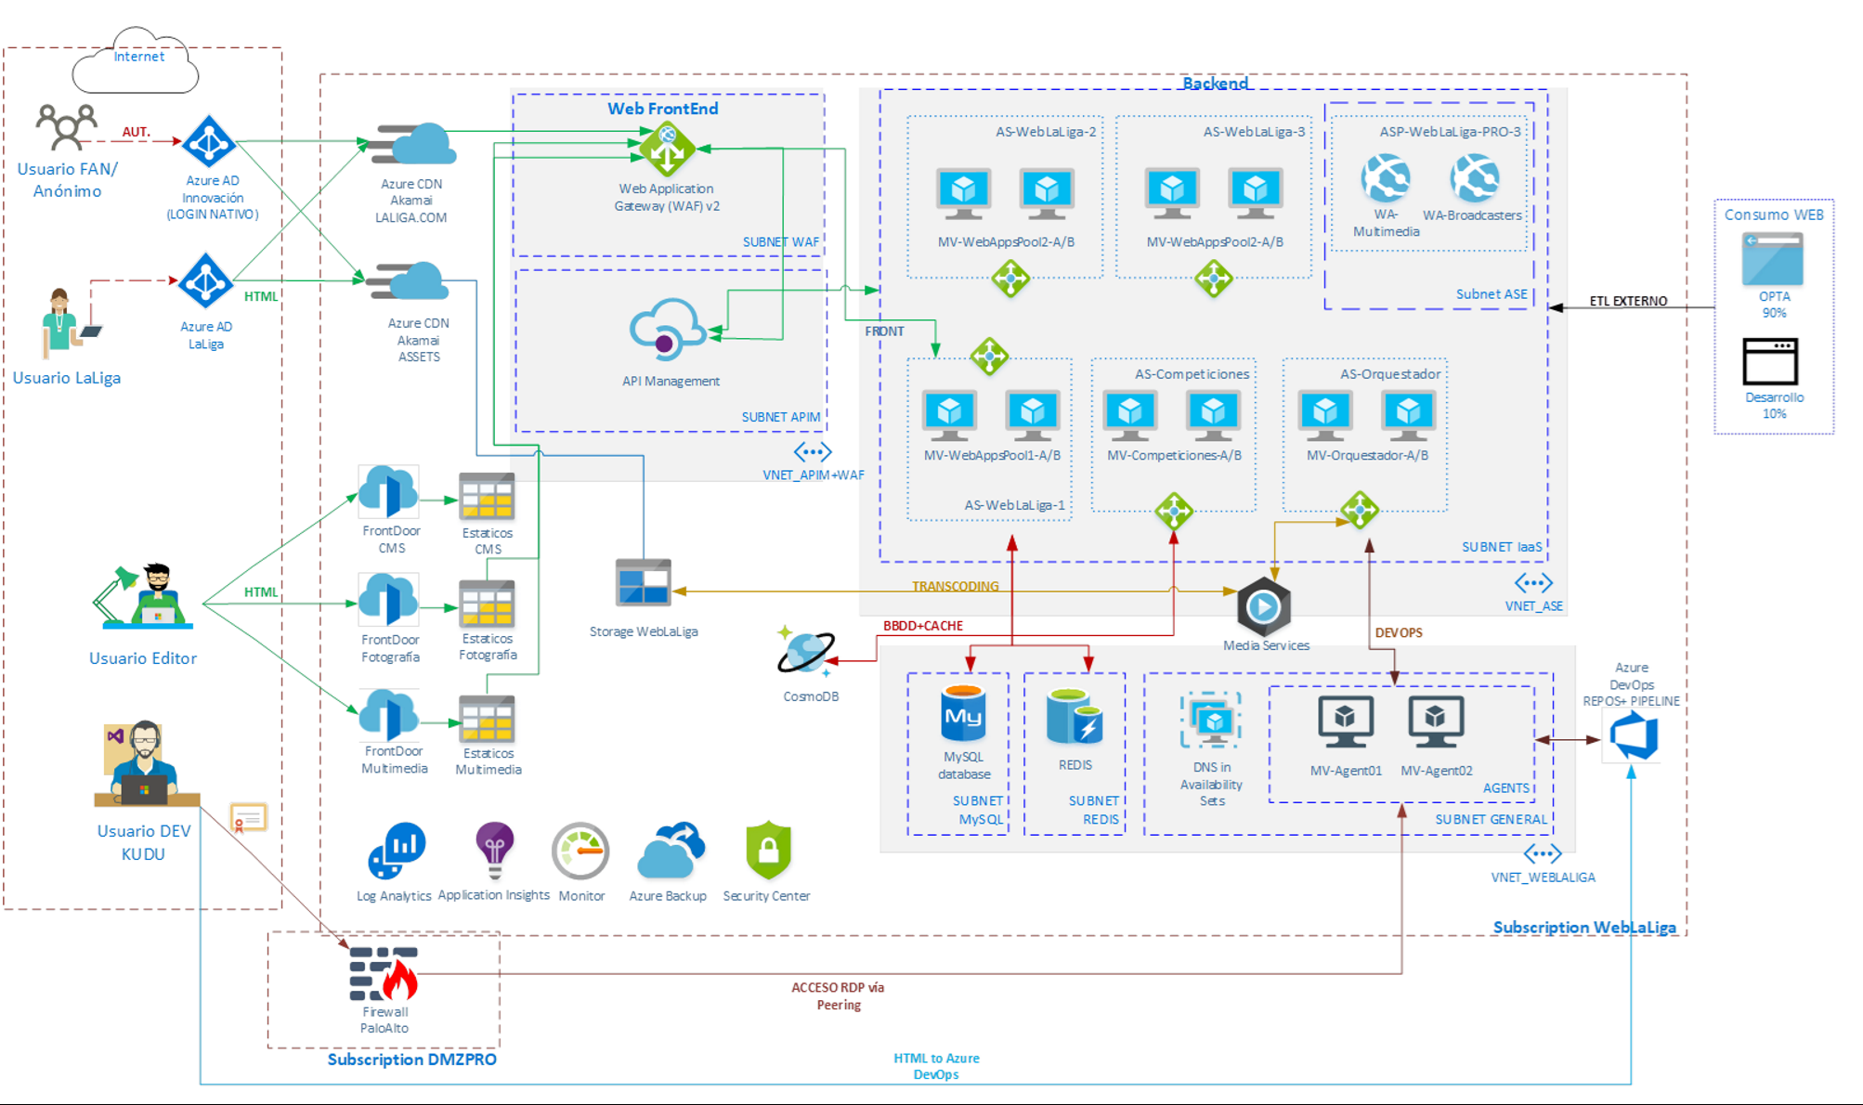
PROPOSAL - Schema

